Slide 1
Chapter 9 PIC USART

Slide 2
Objective
Explain serial communication protocol
Describe data transfer rate and bps rate
Interface the PIC18 with an RS232 connector
Describe the main registers used by serial communication of the PIC18
Program the PIC18 serial port in Assembly

Slide 3
Introduction
Computers transfer data in two ways: Parallel and Serial.
Parallel: Eight or more data lines, few feet only, short time
Serial: Single data line, long distance
The PIC18 has serial communication capability built into it.

Slide 4
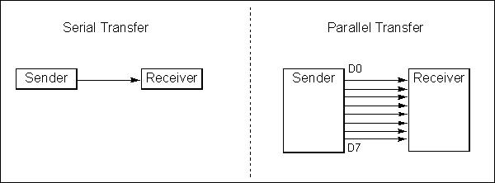
Basics of Serial Communication
The byte of data must be converted to serial bits using a parallel-in-serial-out shift register
Serial versus Parallel Data Transfer

Slide 5
Basics of Serial Communication (cont’d)
The receiving end must be a serial-in-parallel-out shift register and pack them into a byte.
Two methods of serial data communication: Asynchronous and Synchronous
Transfers a block of data at a time
Transfers a single byte at a time

Slide 6
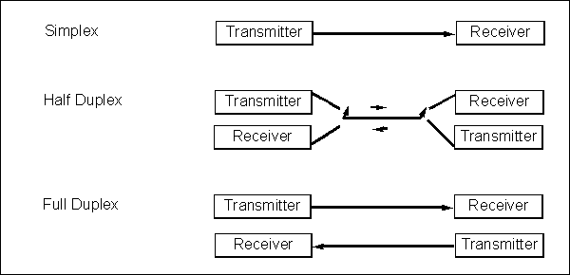
Half-and Full-Duplex Transmission

Slide 7
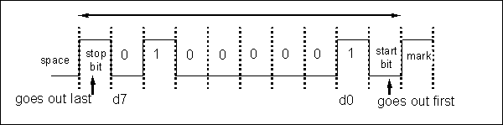
Start and Stop Bits
In the asynchronous method, each character is placed between start and stop bits (framing)
MSB
LSB
Framing ASCII ‘A’ (41H)

Slide 8
Asynchronous serial data transmission
An asynchronous serial data link is said to be character oriented (7 or 8 information bits and plus several control bits). When no information is being transmitted, the line is in an idle state. Traditionally, idle state is referred to as the mark level - a logical 1 level.
A start bit: This bit precedes the first data bit indicating the beginning of a character. The start bit is a logical zero, commonly referred to as a space.
Seven to eight data bits: The number of data bits may be either seven or eight (software set by the user). The LSB bit is transmitted first and the MSB, last.
An optional even or odd parity bit: If used, a parity bit is added after the last (MSB) data bit. For even parity, the parity bit is set such that the total number of 1s, including itself, is even. For odd parity, the total number of 1s in data and parity bits is odd.
One or more stop bits: Each character is terminated with one or more stop bits. A stop bit is a logical 1, commonly referred to as a mark.
8
Notes:
8

Slide 9
Data Transfer Rate
Rate of data transfer: bps (bits per second)
Another widely used terminology for bps is baud rate
For Asynchronous serial data communication, the baud rate is generally limited to 100,000bps

Slide 10
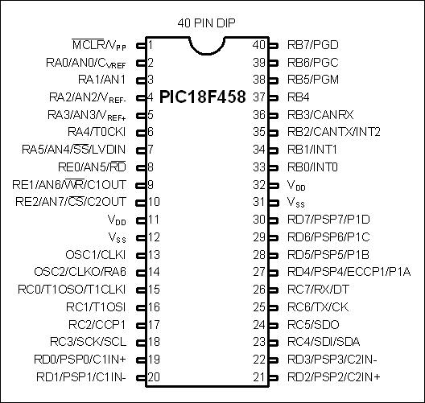
SPIC18 Serial Port Programming in Assembly
USART has both
Synchronous
Asynchronous
6 registers
SPBRG
TXREG
RCREG
TXSTA
RCSTA
PIR1
Rx Port
Tx Port

Slide 11
SPBRG Register and Baud Rate in the PIC18
The baud rate can be calculated using the following equations:
BRGH | Baud Rate
0
1
X = in 8 bit mode (default)

Slide 12
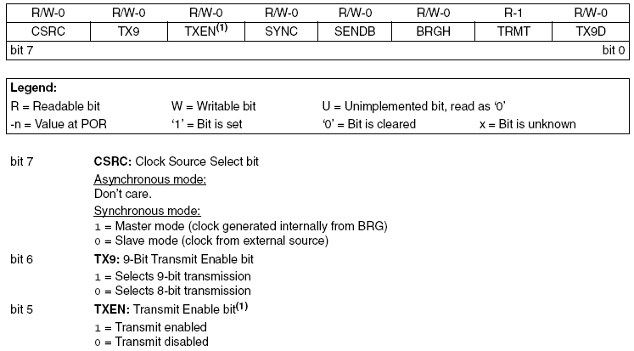
TXSTA (Transmit Status and Control Register)

Slide 13
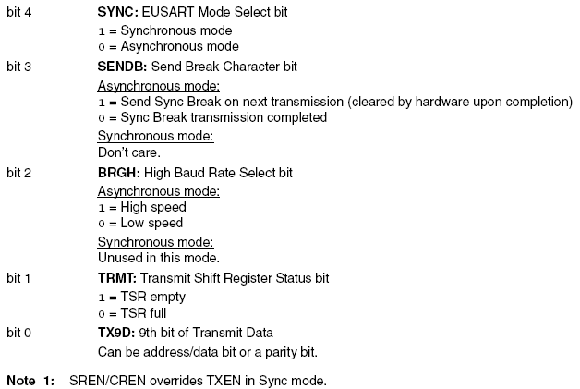
TXSTA (Transmit Status and Control Register) (Cont’d)

Slide 14
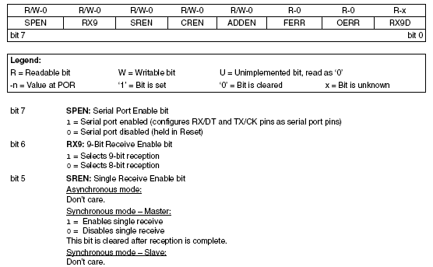
RCSTA (Receive Status and Control Register)

Slide 15
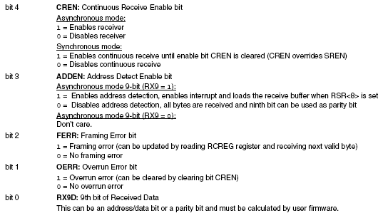
RCSTA (Receive Status and Control Register) (Cont’d)

Slide 16
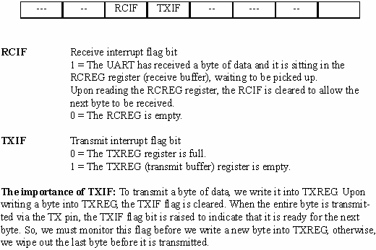
PIR1 (Peripheral Interrupt Request Register 1)

Slide 17
UART TX in more detail
Before transmission, three bits must be specified:
SPEN = 1 – to enable the UART module
TXEN = 1 – to enable the TX module
SYNC = 0 – asynchronous TX
TXIF (TXREG empty) flag is set when TXEN is set
Write to TXREG.
Two Events:
Content of TXREG is transferred to TSR. TXIF is set again.
TSR is filled. TRMT (TSR empty) flag becomes 0.
A byte, framed between the start and stop bit, is transmitted out.
Once the stop bit has been sent out, TRMT becomes 1.

Slide 18
Setting up Asynchronous TX (4 Mhz)
Main: movlw b'00100100' movwf TXSTA movlw b'10010000' movwf RCSTA movlw D’25’ movwf SPBRG movlw ‘A’ call putChar bra $ putChar: btfss TXSTA, TRMT bra putChar movwf TXREG return | ; TXEN = 1, SYNC = 0, BRGH = 1 ; SPEN = 1 ; Set Baud rate for 9600 ; wait until the last TX finishes ; TRMT = 1 if TX finishes ; Put ‘A’ into TXREG

Slide 19
Setting up Asynchronous TX (10 Mhz)
Main: movlw b'00100100' movwf TXSTA movlw b'10010000' movwf RCSTA movlw D’64’ movwf SPBRG movlw ‘A’ call putChar bra $ putChar: btfss TXSTA, TRMT bra putChar movwf TXREG return | ; TXEN = 1, SYNC = 0, BRGH = 1 ; SPEN = 1 ; Set Baud rate for 9600 ; wait until the last TX finishes ; TRMT = 1 if TX finishes ; Put ‘A’ into TXREG

Slide 20
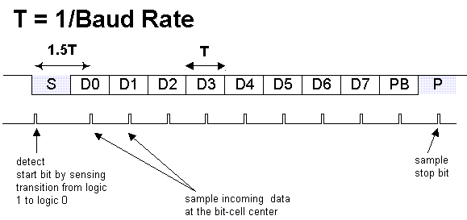
PIC18 UART Reception
Receiver must know the transmission baud rate in order to sample correctly.
If the stop bit of 1 is not detected, framing error occurs.

Slide 21
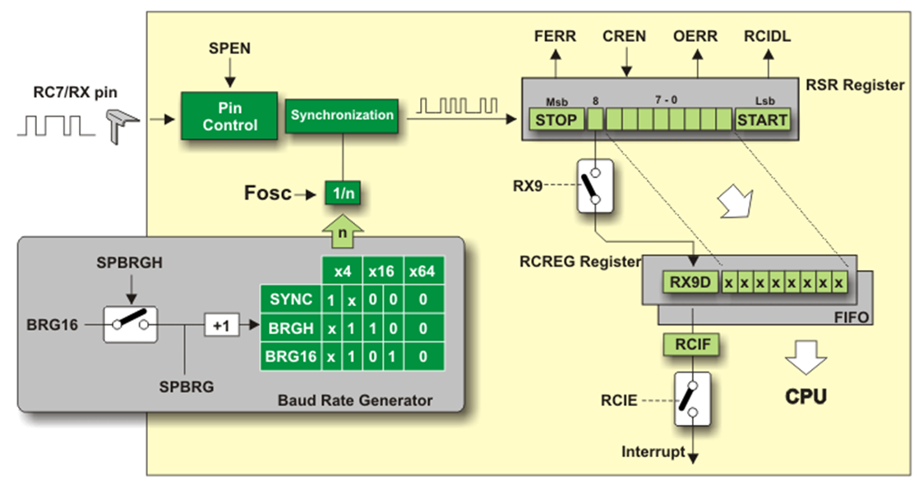
PIC18 UART Reception
USART peripheral needs to be enabled (RCSTA.SPEN)
Receiving on UART needs to be enabled (RCSTA.CREN)
The PIR1.RCIF flag will be raised by the microcontroller after it received a valid byte.
The user needs to copy the received byte out of RCREG. This will automatically reset RCIF.

Slide 22
PIC18 UART Reception
This example receives bytes and output to PORTD (4 Mhz)
Main: clrf TRISD movlw b'00100100' movwf TXSTA movlw b'10010000' movwf RCSTA movlw 25 movwf SPBRG MainLoop: btfss PIR1, RCIF bra MainLoop movff RCREG, PORTD bra MainLoop | ; set PORTD as output ; SPEN = 1, SYNC = 0, BRGH = 1 ; SPEN = 1, CREN = 1 ; Set Baud rate for 9600 ; wait until receiving a complete byte ; move the received byte to PORTD

Slide 23
PIC18 UART Reception
In practice, we will not use polling to wait an input. We use the interrupt concept.
In software,
Configure some registers to enable the UART RX interrupt in the beginning part of the program.
Write an interrupt service routine to process the input byte.
So, in the normal condition, the system serves some other tasks. When an input byte is arrived, the hardware will generate an interrupt (for UART RX). The CPU will finish the current instruction. After identify the source of interrupts (using polling to identify, check IF bits of each possible source), the CPU can jump the UART RX service routine.

